Slide 1
Health Charges
Julia Sheriff
November 12, 2018

Slide 2
APPROACH
INTRODUCTION
THE DATA
CAVEATS
EXPLORATORY DATA ANALYSIS
PREDICTIVE MODELS
CONCLUSION

Slide 3
INTRODUCTION
Study of effects of various personal characteristics on health charges
Used to estimate health charges for varied populations
Estimates can be used in the design of insurance plans across varied populations

Slide 4
THE DATA
Health data collected from 1386 US adults ages 18-65 across the US
7 columns:
Age
Sex
BMI
Number of Children
Smoking Status
Region
Charges

Slide 5
CAVEATS
How was the sampling done? Is the data biased?
-Different insurance providers may have different population makeups (ex: Medicaid versus private insurance)
-Different populations attend different health care organizations, which creates differences in the provision of services and charges per population
-While region was given, was data collected from both urban and rural populations?
A limited number of personal facets were studied

Slide 6
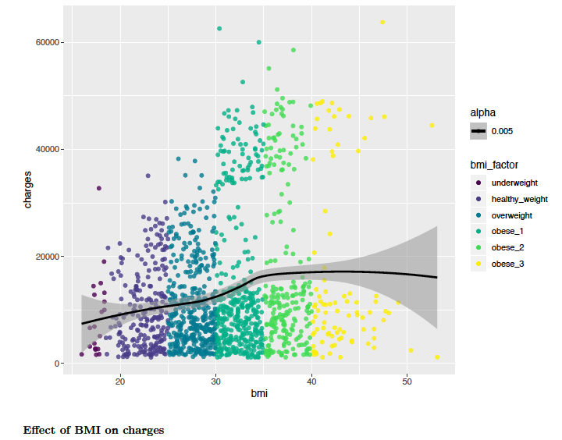
EXPLORATORY ANALYSIS
BMI and CHARGES
There appears to be a weak linear relationship between bmi and charges up to a bmi of 35.
There appears to be no linear relationship between charges and bmi above 35.

Slide 7
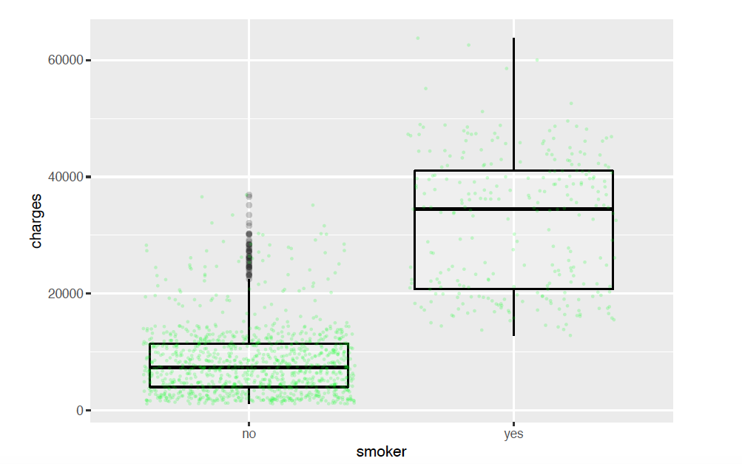
EXPLORATORY DATA ANALYSIS
SMOKERS DATA DISTRIBUTION
Charges for smokers are higher than for non-smokers.
There are no outliers for smokers. Smokers’ charges consistently fall within a predictable range.

Slide 8
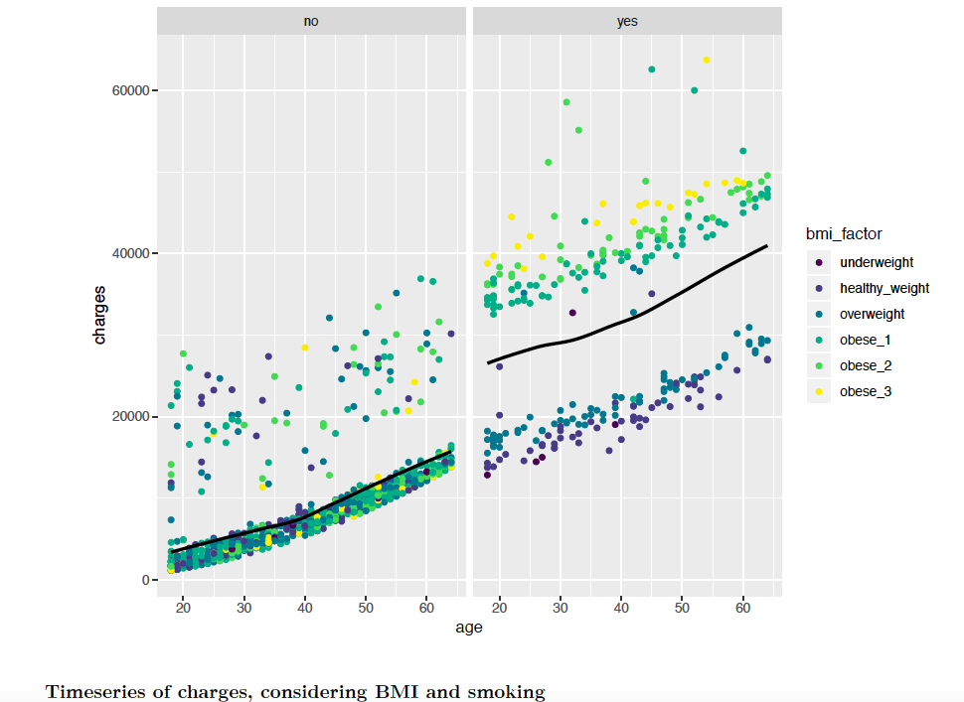
EXPLORATORY DATA ANALYSIS
TIMESERIES:
AGE and CHARGES
As age increases, charges increase.
The range of charges for smokers is greater than that of non-smokers.
There is a clear positive relationship between bmi and charges for smokers. The relationship is less clear for non-smokers.

Slide 9
PREDICTIVE MODELS
CHECKED FOR MISSING / ERRONEOUS DATA
TRANSFORMED CONTINUOUS DATA TO CATEGORICAL DATA
CHARGES – HIGH / LOW (1.75 IQR)
AGE – 10 YEAR INTERVALS
BMI
UNDERWEIGHT
HEALTHYWEIGHT
OVERWEIGHT
OBESE 1
OBESE 2
OBESE 3
CREATED BINARY / DUMMY VARIABLES

Slide 10
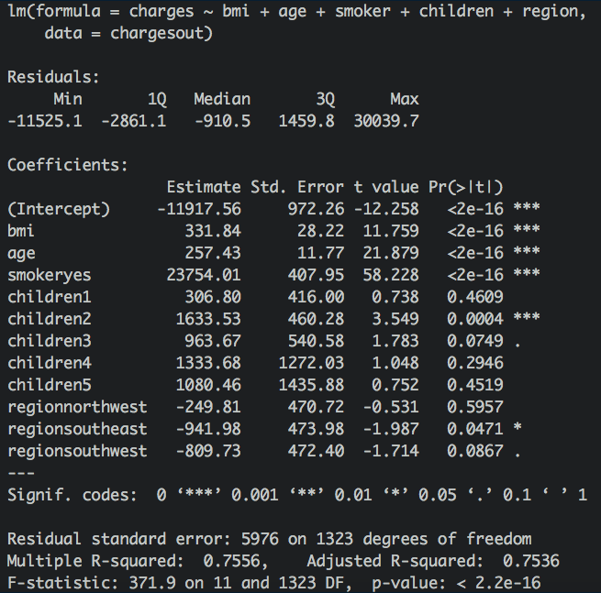
General Linear Regression
No high collinearity between variables
Insignificant variable removed (sex)
Most significant variables were
Smoker
Age
Bmi
Having two children
Three outliers removed from dataset
R^2 = .7536

Slide 11
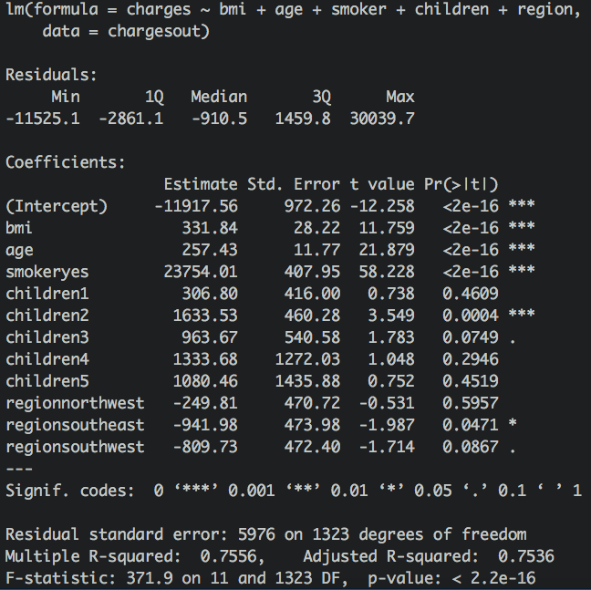
LINEAR REGRESSION OF “HIGH” CHARGES DATA
Smoker: stronger predictor for the general population than “high” charges population
* Difference in charges: $23616.0 versus $9586.85
* Difference in Rˆ2: 0.6195 versus 0.1342
– Bmi: stronger predictor for population with “high” charges than general population
* Difference in charges: $393.87 versus $1166.60
* Difference in Rˆ2: 0.03862 versus 0.4016

Slide 12

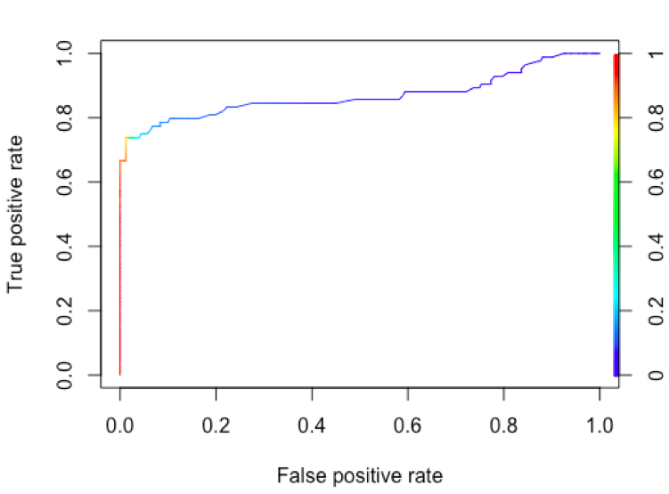
LOGISTIC REGRESSION
Done on “high” versus “low” charges
-”High” = above 1.75 IQR
“Low” = below 1.75 IQR
Model predicts accurately at 93.02%
Sensitivity: true positive rate: 0.7380952
Specificity: false positive rate: 0.01992032
AUC: 0.8706.

Slide 13
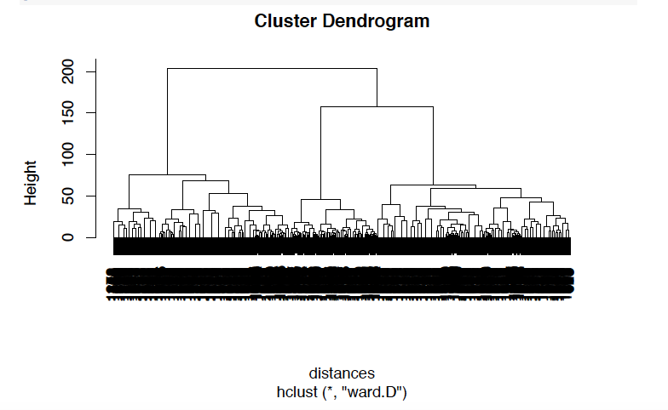
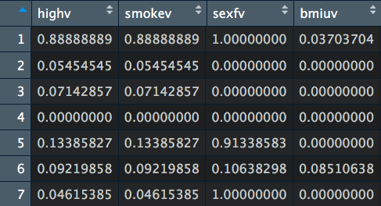
CLUSTERING
Heigharchial clustering modeling
Only cluster correlated with high charges contained a high number of smokers. All other variables were insignificant within that cluster.
Percentage of high charges and smokers were practically identical within every cluster
Clustering model without smoker facet provided inconclusive results.

Slide 14
CONCLUSIONS:
Adjusted R-squared: .7536, so the 75% of the value of charges can be attributed to the variables in this data set.
Smoking significantly increases charges, at $23754.01
Significant variables for linear regression:
Having 2 children increases charges by 1633.53.
Having 3 children increases charges by 963.67.
higher bmi increases charges by $331.84
higher age increases charges by $257.43
region:
Living in the southeast decreased charges by $941.98.
Living in the southwest decreased charges by $809.73.
Accurate logistic regression for predicting “high” charges at 93.02%
This model will change depending on the definition of “high” charges
Clustering supported the conclusion that smoking has a high impact on charges
Bias in data collection could create discrepancies in the true impact of the variables discussed on health charges

